Slide 1
Data Mining:
Concepts and Techniques
— Slides for Textbook —
— Chapter 7 —
©Jiawei Han and Micheline Kamber
Intelligent Database Systems Research Lab
School of Computing Science
Simon Fraser University, Canada
http://www.cs.sfu.ca

Slide 2
Chapter 7. Classification and Prediction
What is classification? What is prediction?
Issues regarding classification and prediction
Classification by decision tree induction
Bayesian Classification
Classification by backpropagation
Classification based on concepts from association rule mining
Other Classification Methods
Prediction
Classification accuracy
Summary

Slide 3
Classification vs. Prediction*
Classification:
  predicts categorical class labels
  classifies data (constructs a model) based on the training set and the values (class labels) in a classifying attribute and uses it in classifying new data
Prediction:
  models continuous-valued functions, i.e., predicts unknown or missing values
Typical Applications
  credit approval: risky or not risky
  target marketing: May by a computer
  medical diagnosis: May suffer from cancer
  treatment effectiveness analysis

Slide 4
Classification—A Two-Step Process *
Model construction: describing a set of predetermined classes
  Each tuple/sample is assumed to belong to a predefined class, as determined by the class label attribute
  The set of tuples used for model construction: training set
  The model is represented as classification rules, decision trees, or mathematical formulae
Model usage: for classifying future or unknown objects
  Estimate accuracy of the model
    The known label of test sample is compared with the classified result from the model
    Accuracy rate is the percentage of test set samples that are correctly classified by the model
    Test set is independent of training set, otherwise over-fitting will occur

Slide 5


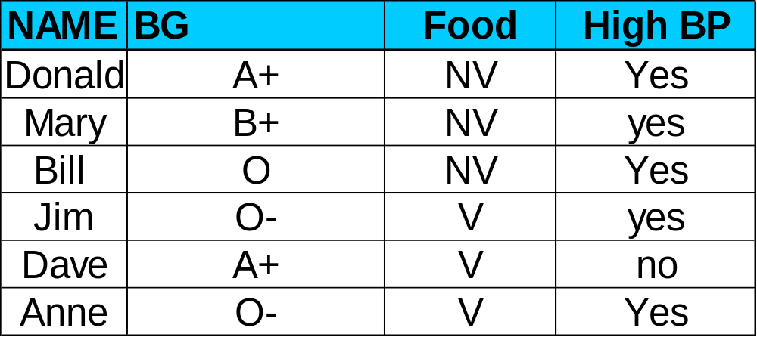
Classification Process (1): Model Construction*
Classification
Algorithms
Training
Data
Classifier
(Model)
IF BG = ‘O-’
OR Food =“NV”
THEN High BP = ‘yes’

Slide 6


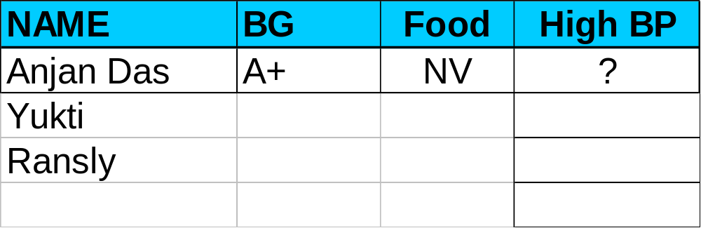

Classification Process (2): Use the Model in Prediction*
Classifier
Testing
Data
Unseen Data
(Anjan Das, A+ , NV)
High BP?

Slide 7
Supervised vs. Unsupervised Learning*
Supervised learning (classification)
  Supervision: The training data (observations, measurements, etc.) are accompanied by labels indicating the class of the observations
  New data is classified based on the training set
Unsupervised learning (clustering)
  The class labels of training data is unknown
  Given a set of measurements, observations, etc. with the aim of establishing the existence of classes or clusters in the data

Slide 8
Chapter 7. Classification and Prediction
What is classification? What is prediction?
Issues regarding classification and prediction
Classification by decision tree induction
Bayesian Classification
Classification by backpropagation
Classification based on concepts from association rule mining
Other Classification Methods
Prediction
Classification accuracy
Summary

Slide 9
Issues regarding classification and prediction (1): Data Preparation*
Data cleaning
  Preprocess data in order to reduce noise and handle missing values
Relevance analysis (feature selection)
  Remove the irrelevant or redundant attributes
Data transformation
  Generalize and/or normalize data

Slide 10
Issues regarding classification and prediction (2): Evaluating Classification Methods*
Predictive accuracy
Speed and scalability
  time to construct the model
  time to use the model
Robustness
  handling noise and missing values
Scalability
  efficiency in disk-resident databases
Interpretability:
  understanding and insight provded by the model
Goodness of rules
  decision tree size
  compactness of classification rules

Slide 11
Chapter 7. Classification and Prediction
What is classification? What is prediction?
Issues regarding classification and prediction
Classification by decision tree induction
Bayesian Classification
Classification by backpropagation
Classification based on concepts from association rule mining
Other Classification Methods
Prediction
Classification accuracy
Summary

Slide 12
Classification by Decision Tree Induction*
Decision tree
  A flow-chart-like tree structure
  Internal node denotes a test on an attribute
  Branch represents an outcome of the test
  Leaf nodes represent class labels or class distribution
Decision tree generation consists of two phases
  Tree construction
    At start, all the training examples are at the root
    Partition examples recursively based on selected attributes
  Tree pruning
    Identify and remove branches that reflect noise or outliers
Use of decision tree: Classifying an unknown sample
  Test the attribute values of the sample against the decision tree

Slide 13
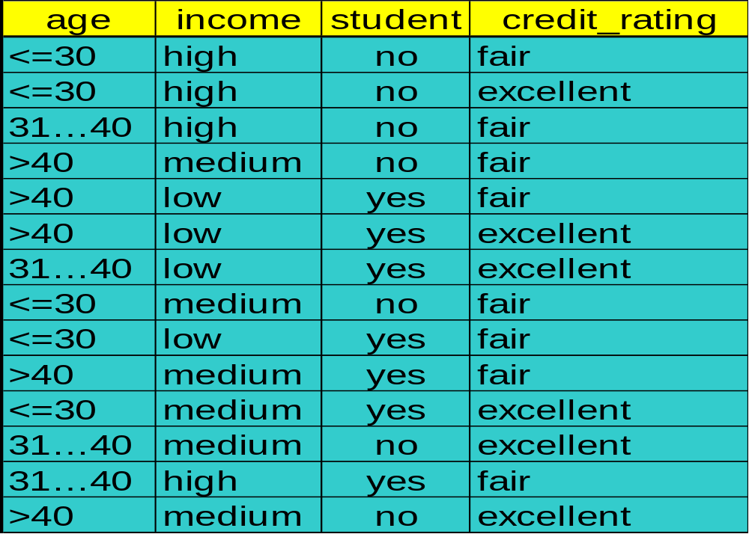
Training Dataset*
This follows an example from Quinlan’s ID3

Slide 14
Output: A Decision Tree for “buys_computer”*
age?
<=30
overcast
>40
30..40
student?
yes
credit rating?
no
yes
excellent
fair
no
yes
no
yes

Slide 15
Algorithm for Decision Tree Induction*
Basic algorithm (a greedy algorithm)
  Tree is constructed in a top-down recursive divide-and-conquer manner
  At start, all the training examples are at the root
  Attributes are categorical (if continuous-valued, they are discretized in advance)
  Examples are partitioned recursively based on selected attributes
  Test attributes are selected on the basis of a heuristic or statistical measure (e.g., information gain)
Conditions for stopping partitioning
  All samples for a given node belong to the same class
  There are no remaining attributes for further partitioning – majority voting is employed for classifying the leaf
  There are no samples left

Slide 16
Attribute Selection Measure
Information gain (ID3/C4.5)
  All attributes are assumed to be categorical
  Can be modified for continuous-valued attributes
Gini index (IBM IntelligentMiner)
  All attributes are assumed continuous-valued
  Assume there exist several possible split values for each attribute
  May need other tools, such as clustering, to get the possible split values
  Can be modified for categorical attributes

Slide 17
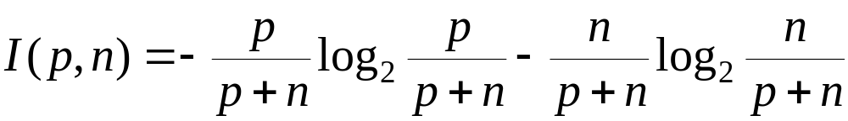
Information Gain (ID3/C4.5)
Select the attribute with the highest information gain
Assume there are two classes, P and N
  Let the set of examples S contain p elements of class P and n elements of class N
  The amount of information, needed to decide if an arbitrary example in S belongs to P or N is defined as

Slide 18
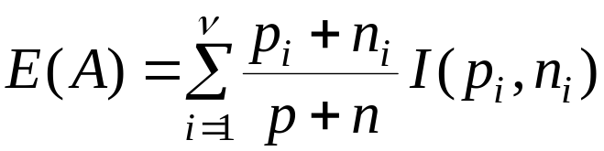

Information Gain in Decision Tree Induction
Assume that using attribute A a set S will be partitioned into sets {S₁, S₂ , …, S_{v}}
  If S_{i} contains p_{i} examples of P and n_{i} examples of N, the entropy, or the expected information needed to classify objects in all subtrees S_{i} is
The encoding information that would be gained by branching on A

Slide 19
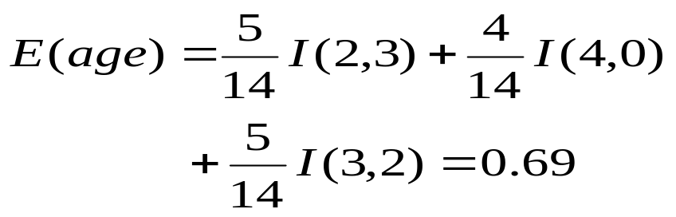


Attribute Selection by Information Gain Computation
Hence
Similarly
Class P: buys_computer = “yes”
Class N: buys_computer = “no”
I(p, n) = I(9, 5) =0.940
Compute the entropy for age:

Slide 20
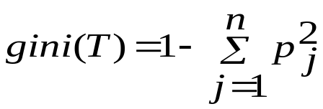
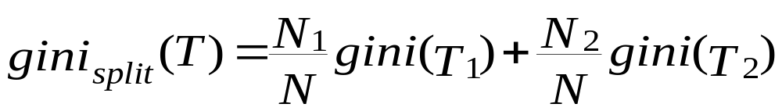
Gini Index (IBM IntelligentMiner)
If a data set T contains examples from n classes, gini index, gini(T) is defined as
where p_{j} is the relative frequency of class j in T.
If a data set T is split into two subsets T₁ and T₂ with sizes N₁ and N₂ respectively, the gini index of the split data contains examples from n classes, the gini index gini(T) is defined as
The attribute provides the smallest gini_{split}(T) is chosen to split the node (need to enumerate all possible splitting points for each attribute).

Slide 21
Extracting Classification Rules from Trees*
Represent the knowledge in the form of IF-THEN rules
One rule is created for each path from the root to a leaf
Each attribute-value pair along a path forms a conjunction
The leaf node holds the class prediction
Rules are easier for humans to understand
Example
  IF age = “<=30” AND student = “no” THEN buys_computer = “no”
  IF age = “<=30” AND student = “yes” THEN buys_computer = “yes”
  IF age = “31…40” THEN buys_computer = “yes”
  IF age = “>40” AND credit_rating = “excellent” THEN buys_computer = “yes”
  IF age = “>40” AND credit_rating = “fair” THEN buys_computer = “no”

Slide 22
Avoid Overfitting in Classification
The generated tree may overfit the training data
  Too many branches, some may reflect anomalies due to noise or outliers
  Result is in poor accuracy for unseen samples
Two approaches to avoid overfitting
  Prepruning: Halt tree construction early—do not split a node if this would result in the goodness measure falling below a threshold
    Difficult to choose an appropriate threshold
  Postpruning: Remove branches from a “fully grown” tree—get a sequence of progressively pruned trees
    Use a set of data different from the training data to decide which is the “best pruned tree”

Slide 23
Approaches to Determine the Final Tree Size
Separate training (2/3) and testing (1/3) sets
Use cross validation, e.g., 10-fold cross validation
Use all the data for training
  but apply a statistical test (e.g., chi-square) to estimate whether expanding or pruning a node may improve the entire distribution
Use minimum description length (MDL) principle:
  halting growth of the tree when the encoding is minimized

Slide 24
Enhancements to basic decision tree induction
Allow for continuous-valued attributes
  Dynamically define new discrete-valued attributes that partition the continuous attribute value into a discrete set of intervals
Handle missing attribute values
  Assign the most common value of the attribute
  Assign probability to each of the possible values
Attribute construction
  Create new attributes based on existing ones that are sparsely represented
  This reduces fragmentation, repetition, and replication

Slide 25
Classification in Large Databases
Classification—a classical problem extensively studied by statisticians and machine learning researchers
Scalability: Classifying data sets with millions of examples and hundreds of attributes with reasonable speed
Why decision tree induction in data mining?
  relatively faster learning speed (than other classification methods)
  convertible to simple and easy to understand classification rules
  can use SQL queries for accessing databases
  comparable classification accuracy with other methods

Slide 26
Scalable Decision Tree Induction Methods in Data Mining Studies
SLIQ (EDBT’96 — Mehta et al.)
  builds an index for each attribute and only class list and the current attribute list reside in memory
SPRINT (VLDB’96 — J. Shafer et al.)
  constructs an attribute list data structure
PUBLIC (VLDB’98 — Rastogi & Shim)
  integrates tree splitting and tree pruning: stop growing the tree earlier
RainForest (VLDB’98 — Gehrke, Ramakrishnan & Ganti)
  separates the scalability aspects from the criteria that determine the quality of the tree
  builds an AVC-list (attribute, value, class label)

Slide 27
Data Cube-Based Decision-Tree Induction
Integration of generalization with decision-tree induction (Kamber et al’97).
Classification at primitive concept levels
  E.g., precise temperature, humidity, outlook, etc.
  Low-level concepts, scattered classes, bushy classification-trees
  Semantic interpretation problems.
Cube-based multi-level classification
  Relevance analysis at multi-levels.
  Information-gain analysis with dimension + level.

Slide 28

Presentation of Classification Results

Slide 29
Chapter 7. Classification and Prediction
What is classification? What is prediction?
Issues regarding classification and prediction
Classification by decision tree induction
Bayesian Classification
Classification by backpropagation
Classification based on concepts from association rule mining
Other Classification Methods
Prediction
Classification accuracy
Summary

Slide 30
Bayesian Classification: Why?
Probabilistic learning: Calculate explicit probabilities for hypothesis, among the most practical approaches to certain types of learning problems
Incremental: Each training example can incrementally increase/decrease the probability that a hypothesis is correct. Prior knowledge can be combined with observed data.
Probabilistic prediction: Predict multiple hypotheses, weighted by their probabilities
Standard: Even when Bayesian methods are computationally intractable, they can provide a standard of optimal decision making against which other methods can be measured

Slide 31
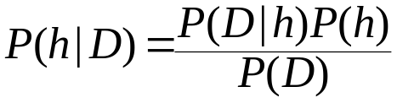
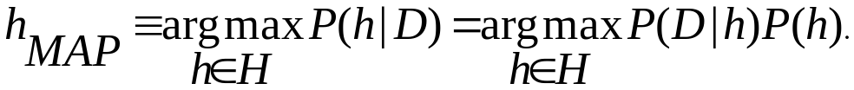
Bayesian Theorem
Given training data D, posteriori probability of a hypothesis h, P(h|D) follows the Bayes theorem
MAP (maximum posteriori) hypothesis
Practical difficulty: require initial knowledge of many probabilities, significant computational cost

Slide 32
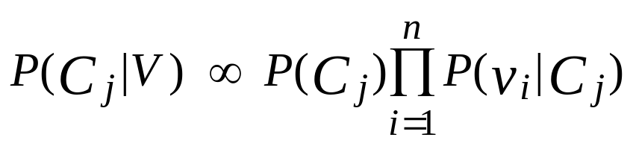
Naïve Bayes Classifier (I)
A simplified assumption: attributes are conditionally independent:
Greatly reduces the computation cost, only count the class distribution.

Slide 33
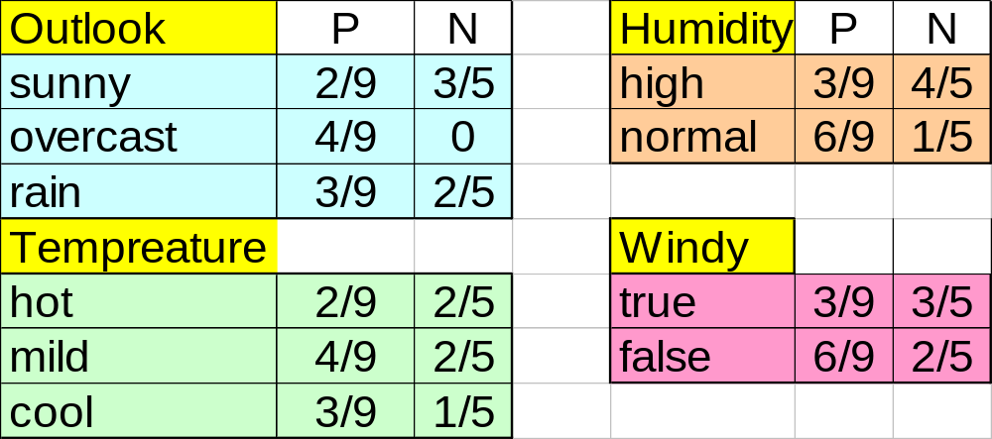
Naive Bayesian Classifier (II)
Given a training set, we can compute the probabilities

Slide 34
Bayesian classification
The classification problem may be formalized using a-posteriori probabilities:
P(C|X) = prob. that the sample tuple X=<x₁,…,x_{k}> is of class C.
E.g. P(class=N | outlook=sunny,windy=true,…)
Idea: assign to sample X the class label C such that P(C|X) is maximal

Slide 35
Estimating a-posteriori probabilities
Bayes theorem:
P(C|X) = P(X|C)·P(C) / P(X)
P(X) is constant for all classes
P(C) = relative freq of class C samples
C such that P(C|X) is maximum =
C such that P(X|C)·P(C) is maximum
Problem: computing P(X|C) is unfeasible!

Slide 36
Naïve Bayesian Classification
Naïve assumption: attribute independence
P(x₁,…,x_{k}|C) = P(x₁|C)·…·P(x_{k}|C)
If i-th attribute is categorical:
P(x_{i}|C) is estimated as the relative freq of samples having value x_{i} as i-th attribute in class C
If i-th attribute is continuous:
P(x_{i}|C) is estimated thru a Gaussian density function
Computationally easy in both cases

Slide 37
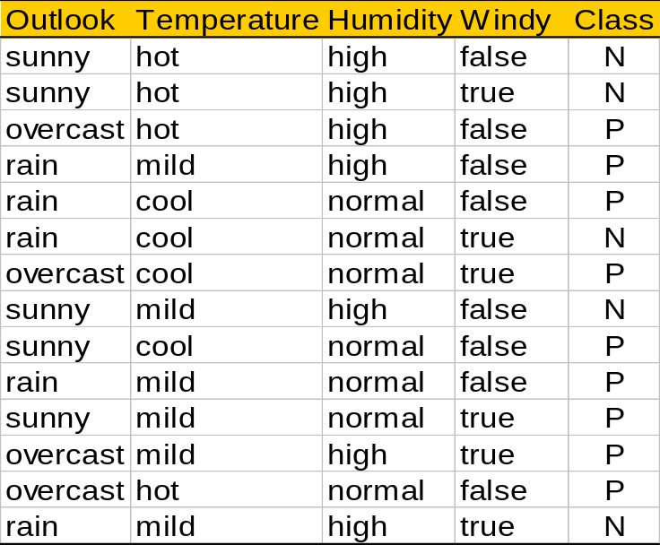
Play-tennis example: estimating P(x_{i}|C)
outlook
P(sunny|p) = 2/9 | P(sunny|n) = 3/5
P(overcast|p) = 4/9 | P(overcast|n) = 0
P(rain|p) = 3/9 | P(rain|n) = 2/5
temperature
P(hot|p) = 2/9 | P(hot|n) = 2/5
P(mild|p) = 4/9 | P(mild|n) = 2/5
P(cool|p) = 3/9 | P(cool|n) = 1/5
humidity
P(high|p) = 3/9 | P(high|n) = 4/5
P(normal|p) = 6/9 | P(normal|n) = 2/5
windy
P(true|p) = 3/9 | P(true|n) = 3/5
P(false|p) = 6/9 | P(false|n) = 2/5
P(p) = 9/14
P(n) = 5/14

Slide 38
Play-tennis example: classifying X
An unseen sample X = <rain, hot, high, false>
P(X|p)·P(p) =
P(rain|p)·P(hot|p)·P(high|p)·P(false|p)·P(p) = 3/9·2/9·3/9·6/9·9/14 = 0.010582
P(X|n)·P(n) =
P(rain|n)·P(hot|n)·P(high|n)·P(false|n)·P(n) = 2/5·2/5·4/5·2/5·5/14 = 0.018286
Sample X is classified in class n (don’t play)

Slide 39
The independence hypothesis…
… makes computation possible
… yields optimal classifiers when satisfied
… but is seldom satisfied in practice, as attributes (variables) are often correlated.
Attempts to overcome this limitation:
  Bayesian networks, that combine Bayesian reasoning with causal relationships between attributes
  Decision trees, that reason on one attribute at the time, considering most important attributes first

Slide 40
Bayesian Belief Networks (I)
Family
History
Smoker
(FH, S)
(FH, ~S)
(~FH, S)
(~FH, ~S)
LC
0.8
0.5
0.7
0.1
LungCancer
Emphysema
~LC
0.2
0.5
0.3
0.9
The conditional probability table for the variable LungCancer
PositiveXRay
Dyspnea
Bayesian Belief Networks

Slide 41
Bayesian Belief Networks (II)
Bayesian belief network allows a subset of the variables conditionally independent
A graphical model of causal relationships
Several cases of learning Bayesian belief networks
  Given both network structure and all the variables: easy
  Given network structure but only some variables
  When the network structure is not known in advance

Slide 42
Chapter 7. Classification and Prediction
What is classification? What is prediction?
Issues regarding classification and prediction
Classification by decision tree induction
Bayesian Classification
Classification by backpropagation
Classification based on concepts from association rule mining
Other Classification Methods
Prediction
Classification accuracy
Summary

Slide 43
Neural Networks
Advantages
  prediction accuracy is generally high
  robust, works when training examples contain errors
  output may be discrete, real-valued, or a vector of several discrete or real-valued attributes
  fast evaluation of the learned target function
Criticism
  long training time
  difficult to understand the learned function (weights)
  not easy to incorporate domain knowledge

Slide 44
A Neuron
-
μ_{k}
x₀
w₀
x₁
w₁
∑
f
output y
x_{n}
w_{n}
Input
vector x
weight
vector w
weighted
sum
Activation
function
The n-dimensional input vector x is mapped into variable y by means of the scalar product and a nonlinear function mapping

Slide 45
Network Training
The ultimate objective of training
  obtain a set of weights that makes almost all the tuples in the training data classified correctly
Steps
  Initialize weights with random values
  Feed the input tuples into the network one by one
  For each unit
    Compute the net input to the unit as a linear combination of all the inputs to the unit
    Compute the output value using the activation function
    Compute the error
    Update the weights and the bias

Slide 46




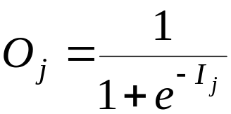
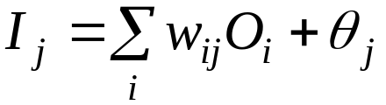
Multi-Layer Perceptron
Output vector
Output nodes
Hidden nodes
w_{ij}
Input nodes
Input vector: x_{i}

Slide 47
Network Pruning and Rule Extraction
Network pruning
  Fully connected network will be hard to articulate
  N input nodes, h hidden nodes and m output nodes lead to h(m+N) weights
  Pruning: Remove some of the links without affecting classification accuracy of the network
Extracting rules from a trained network
  Discretize activation values; replace individual activation value by the cluster average maintaining the network accuracy
  Enumerate the output from the discretized activation values to find rules between activation value and output
  Find the relationship between the input and activation value
  Combine the above two to have rules relating the output to input

Slide 48
Chapter 7. Classification and Prediction
What is classification? What is prediction?
Issues regarding classification and prediction
Classification by decision tree induction
Bayesian Classification
Classification by backpropagation
Classification based on concepts from association rule mining
Other Classification Methods
Prediction
Classification accuracy
Summary

Slide 49
Association-Based Classification
Several methods for association-based classification
  ARCS: Quantitative association mining and clustering of association rules (Lent et al’97)
    It beats C4.5 in (mainly) scalability and also accuracy
  Associative classification: (Liu et al’98)
    It mines high support and high confidence rules in the form of “cond_set => y”, where y is a class label
  CAEP (Classification by aggregating emerging patterns) (Dong et al’99)
    Emerging patterns (EPs): the itemsets whose support increases significantly from one class to another
    Mine Eps based on minimum support and growth rate

Slide 50
Chapter 7. Classification and Prediction
What is classification? What is prediction?
Issues regarding classification and prediction
Classification by decision tree induction
Bayesian Classification
Classification by backpropagation
Classification based on concepts from association rule mining
Other Classification Methods
Prediction
Classification accuracy
Summary

Slide 51
Other Classification Methods
k-nearest neighbor classifier
case-based reasoning
Genetic algorithm
Rough set approach
Fuzzy set approaches

Slide 52
Instance-Based Methods
Instance-based learning:
  Store training examples and delay the processing (“lazy evaluation”) until a new instance must be classified
Typical approaches
  k-nearest neighbor approach
    Instances represented as points in a Euclidean space.
  Locally weighted regression
    Constructs local approximation
  Case-based reasoning
    Uses symbolic representations and knowledge-based inference

Slide 53
The k-Nearest Neighbor Algorithm
All instances correspond to points in the n-D space.
The nearest neighbor are defined in terms of Euclidean distance.
The target function could be discrete- or real- valued.
For discrete-valued, the k-NN returns the most common value among the k training examples nearest to xq.
Vonoroi diagram: the decision surface induced by 1-NN for a typical set of training examples.
_
.
_
_
.
+
_
.
+
.
.
_
xq
+
_
.
+

Slide 54
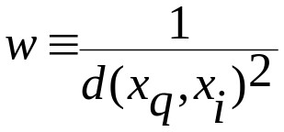
Discussion on the k-NN Algorithm
The k-NN algorithm for continuous-valued target functions
  Calculate the mean values of the k nearest neighbors
Distance-weighted nearest neighbor algorithm
  Weight the contribution of each of the k neighbors according to their distance to the query point x_{q}
    giving greater weight to closer neighbors
  Similarly, for real-valued target functions
Robust to noisy data by averaging k-nearest neighbors
Curse of dimensionality: distance between neighbors could be dominated by irrelevant attributes.
  To overcome it, axes stretch or elimination of the least relevant attributes.

Slide 55
Case-Based Reasoning
Also uses: lazy evaluation + analyze similar instances
Difference: Instances are not “points in a Euclidean space”
Example: Water faucet problem in CADET (Sycara et al’92)
Methodology
  Instances represented by rich symbolic descriptions (e.g., function graphs)
  Multiple retrieved cases may be combined
  Tight coupling between case retrieval, knowledge-based reasoning, and problem solving
Research issues
  Indexing based on syntactic similarity measure, and when failure, backtracking, and adapting to additional cases

Slide 56
Remarks on Lazy vs. Eager Learning
Instance-based learning: lazy evaluation
Decision-tree and Bayesian classification: eager evaluation
Key differences
  Lazy method may consider query instance xq when deciding how to generalize beyond the training data D
  Eager method cannot since they have already chosen global approximation when seeing the query
Efficiency: Lazy - less time training but more time predicting
Accuracy
  Lazy method effectively uses a richer hypothesis space since it uses many local linear functions to form its implicit global approximation to the target function
  Eager: must commit to a single hypothesis that covers the entire instance space

Slide 57
Genetic Algorithms
GA: based on an analogy to biological evolution
Each rule is represented by a string of bits
An initial population is created consisting of randomly generated rules
  e.g., IF A₁ and Not A₂ then C₂ can be encoded as 100
Based on the notion of survival of the fittest, a new population is formed to consists of the fittest rules and their offsprings
The fitness of a rule is represented by its classification accuracy on a set of training examples
Offsprings are generated by crossover and mutation

Slide 58

Rough Set Approach
Rough sets are used to approximately or “roughly” define equivalent classes
A rough set for a given class C is approximated by two sets: a lower approximation (certain to be in C) and an upper approximation (cannot be described as not belonging to C)
Finding the minimal subsets (reducts) of attributes (for feature reduction) is NP-hard but a discernibility matrix is used to reduce the computation intensity

Slide 59

Fuzzy Set Approaches
Fuzzy logic uses truth values between 0.0 and 1.0 to represent the degree of membership (such as using fuzzy membership graph)
Attribute values are converted to fuzzy values
  e.g., income is mapped into the discrete categories {low, medium, high} with fuzzy values calculated
For a given new sample, more than one fuzzy value may apply
Each applicable rule contributes a vote for membership in the categories
Typically, the truth values for each predicted category are summed

Slide 60
Chapter 7. Classification and Prediction
What is classification? What is prediction?
Issues regarding classification and prediction
Classification by decision tree induction
Bayesian Classification
Classification by backpropagation
Classification based on concepts from association rule mining
Other Classification Methods
Prediction
Classification accuracy
Summary

Slide 61
What Is Prediction?
Prediction is similar to classification
  First, construct a model
  Second, use model to predict unknown value
    Major method for prediction is regression
      Linear and multiple regression
      Non-linear regression
Prediction is different from classification
  Classification refers to predict categorical class label
  Prediction models continuous-valued functions

Slide 62
Predictive Modeling in Databases
Predictive modeling: Predict data values or construct generalized linear models based on the database data.
One can only predict value ranges or category distributions
Method outline:
  Minimal generalization
  Attribute relevance analysis
  Generalized linear model construction
  Prediction
Determine the major factors which influence the prediction
  Data relevance analysis: uncertainty measurement, entropy analysis, expert judgement, etc.
Multi-level prediction: drill-down and roll-up analysis

Slide 63
Regress Analysis and Log-Linear Models in Prediction
Linear regression: Y = α + β X
  Two parameters , α and β specify the line and are to be estimated by using the data at hand.
  using the least squares criterion to the known values of Y1, Y2, …, X1, X2, ….
Multiple regression: Y = b0 + b1 X1 + b2 X2.
  Many nonlinear functions can be transformed into the above.
Log-linear models:
  The multi-way table of joint probabilities is approximated by a product of lower-order tables.
  Probability: p(a, b, c, d) = αab βacχad δbcd

Slide 64

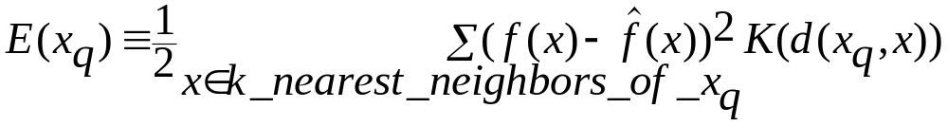
Locally Weighted Regression
Construct an explicit approximation to f over a local region surrounding query instance xq.
Locally weighted linear regression:
  The target function f is approximated near xq using the linear function:
  minimize the squared error: distance-decreasing weight K
  the gradient descent training rule:
In most cases, the target function is approximated by a constant, linear, or quadratic function.

Slide 65
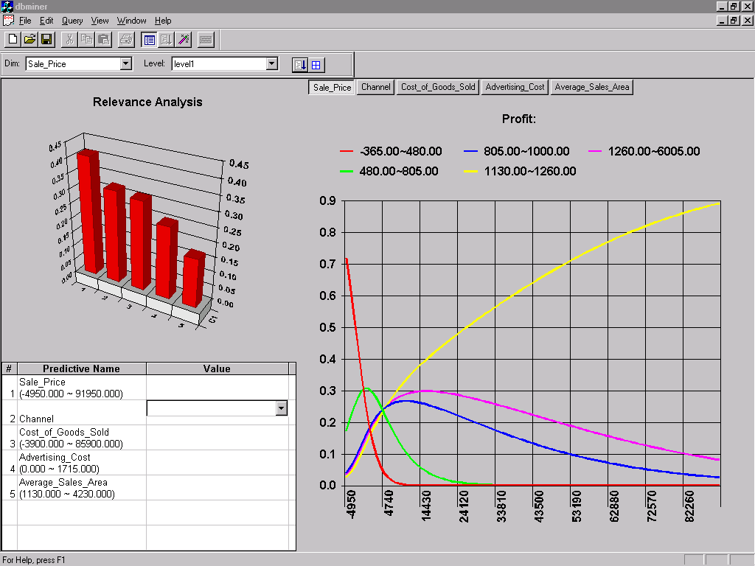
Prediction: Numerical Data

Slide 66
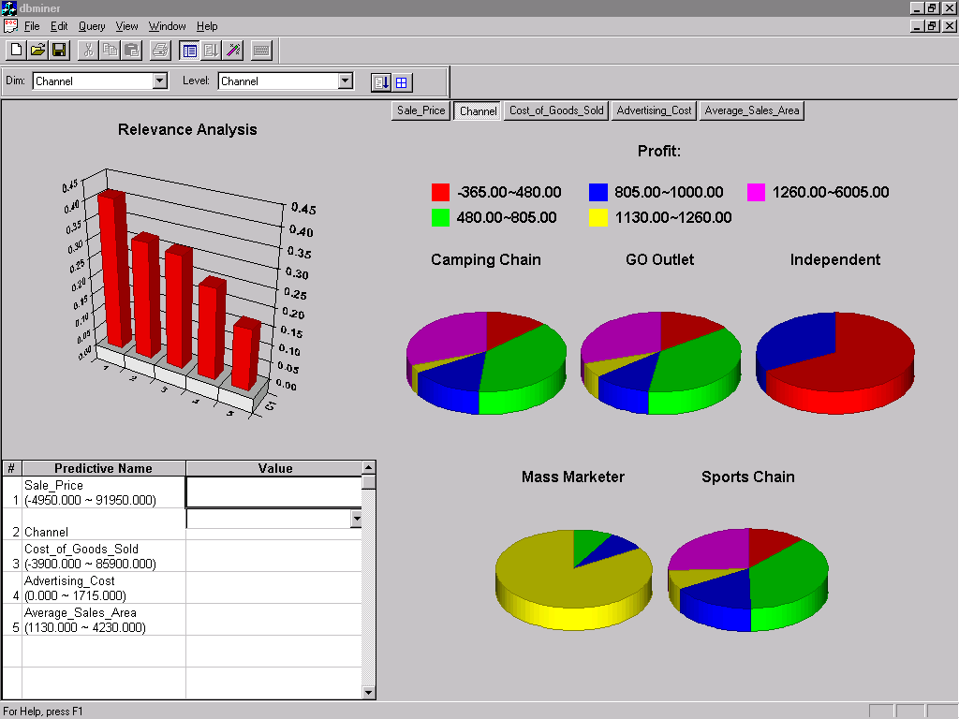
Prediction: Categorical Data

Slide 67
Chapter 7. Classification and Prediction
What is classification? What is prediction?
Issues regarding classification and prediction
Classification by decision tree induction
Bayesian Classification
Classification by backpropagation
Classification based on concepts from association rule mining
Other Classification Methods
Prediction
Classification accuracy
Summary

Slide 68
Classification Accuracy: Estimating Error Rates
Partition: Training-and-testing
  use two independent data sets, e.g., training set (2/3), test set(1/3)
  used for data set with large number of samples
Cross-validation
  divide the data set into k subsamples
  use k-1 subsamples as training data and one sub-sample as test data --- k-fold cross-validation
  for data set with moderate size
Bootstrapping (leave-one-out)
  for small size data

Slide 69
Boosting and Bagging
Boosting increases classification accuracy
  Applicable to decision trees or Bayesian classifier
Learn a series of classifiers, where each classifier in the series pays more attention to the examples misclassified by its predecessor
Boosting requires only linear time and constant space

Slide 70
Boosting Technique (II) — Algorithm
Assign every example an equal weight 1/N
For t = 1, 2, …, T Do
  Obtain a hypothesis (classifier) h^{(t)} under w^{(t)}
  Calculate the error of h(t) and re-weight the examples based on the error
  Normalize w^{(t+1)} to sum to 1
Output a weighted sum of all the hypothesis, with each hypothesis weighted according to its accuracy on the training set

Slide 71
Chapter 7. Classification and Prediction
What is classification? What is prediction?
Issues regarding classification and prediction
Classification by decision tree induction
Bayesian Classification
Classification by backpropagation
Classification based on concepts from association rule mining
Other Classification Methods
Prediction
Classification accuracy
Summary

Slide 72
Summary
Classification is an extensively studied problem (mainly in statistics, machine learning & neural networks)
Classification is probably one of the most widely used data mining techniques with a lot of extensions
Scalability is still an important issue for database applications: thus combining classification with database techniques should be a promising topic
Research directions: classification of non-relational data, e.g., text, spatial, multimedia, etc..

Slide 73
References (I)
C. Apte and S. Weiss. Data mining with decision trees and decision rules. Future Generation Computer Systems, 13, 1997.
L. Breiman, J. Friedman, R. Olshen, and C. Stone. Classification and Regression Trees. Wadsworth International Group, 1984.
P. K. Chan and S. J. Stolfo. Learning arbiter and combiner trees from partitioned data for scaling machine learning. In Proc. 1st Int. Conf. Knowledge Discovery and Data Mining (KDD'95), pages 39-44, Montreal, Canada, August 1995.
U. M. Fayyad. Branching on attribute values in decision tree generation. In Proc. 1994 AAAI Conf., pages 601-606, AAAI Press, 1994.
J. Gehrke, R. Ramakrishnan, and V. Ganti. Rainforest: A framework for fast decision tree construction of large datasets. In Proc. 1998 Int. Conf. Very Large Data Bases, pages 416-427, New York, NY, August 1998.
M. Kamber, L. Winstone, W. Gong, S. Cheng, and J. Han. Generalization and decision tree induction: Efficient classification in data mining. In Proc. 1997 Int. Workshop Research Issues on Data Engineering (RIDE'97), pages 111-120, Birmingham, England, April 1997.

Slide 74
References (II)
J. Magidson. The Chaid approach to segmentation modeling: Chi-squared automatic interaction detection. In R. P. Bagozzi, editor, Advanced Methods of Marketing Research, pages 118-159. Blackwell Business, Cambridge Massechusetts, 1994.
M. Mehta, R. Agrawal, and J. Rissanen. SLIQ : A fast scalable classifier for data mining. In Proc. 1996 Int. Conf. Extending Database Technology (EDBT'96), Avignon, France, March 1996.
S. K. Murthy, Automatic Construction of Decision Trees from Data: A Multi-Diciplinary Survey, Data Mining and Knowledge Discovery 2(4): 345-389, 1998
J. R. Quinlan. Bagging, boosting, and c4.5. In Proc. 13th Natl. Conf. on Artificial Intelligence (AAAI'96), 725-730, Portland, OR, Aug. 1996.
R. Rastogi and K. Shim. Public: A decision tree classifer that integrates building and pruning. In Proc. 1998 Int. Conf. Very Large Data Bases, 404-415, New York, NY, August 1998.
J. Shafer, R. Agrawal, and M. Mehta. SPRINT : A scalable parallel classifier for data mining. In Proc. 1996 Int. Conf. Very Large Data Bases, 544-555, Bombay, India, Sept. 1996.
S. M. Weiss and C. A. Kulikowski. Computer Systems that Learn: Classification and Prediction Methods from Statistics, Neural Nets, Machine Learning, and Expert Systems. Morgan Kaufman, 1991.

Slide 75

http://www.cs.sfu.ca/~han
Thank you !!!

